Slide 1
Let’s get registered for

Slide 2
Visit: Donations.bangorhumane.org/paws30

Slide 3
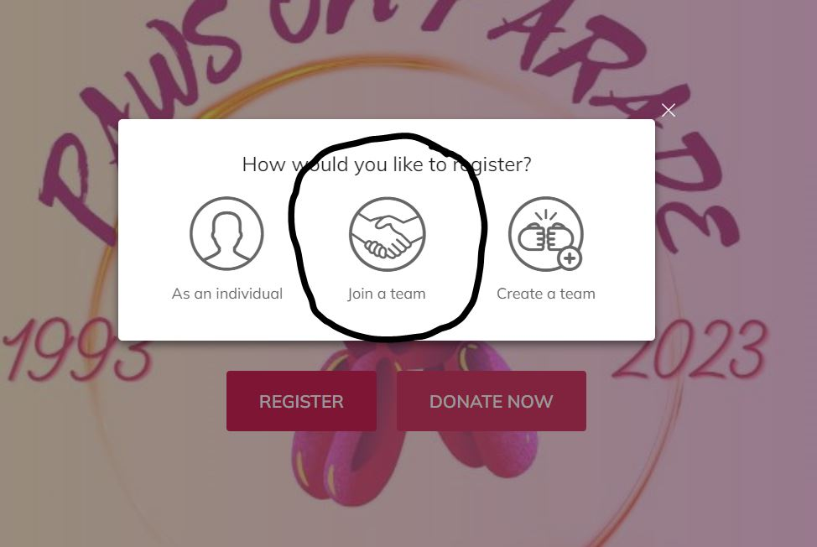

Slide 4
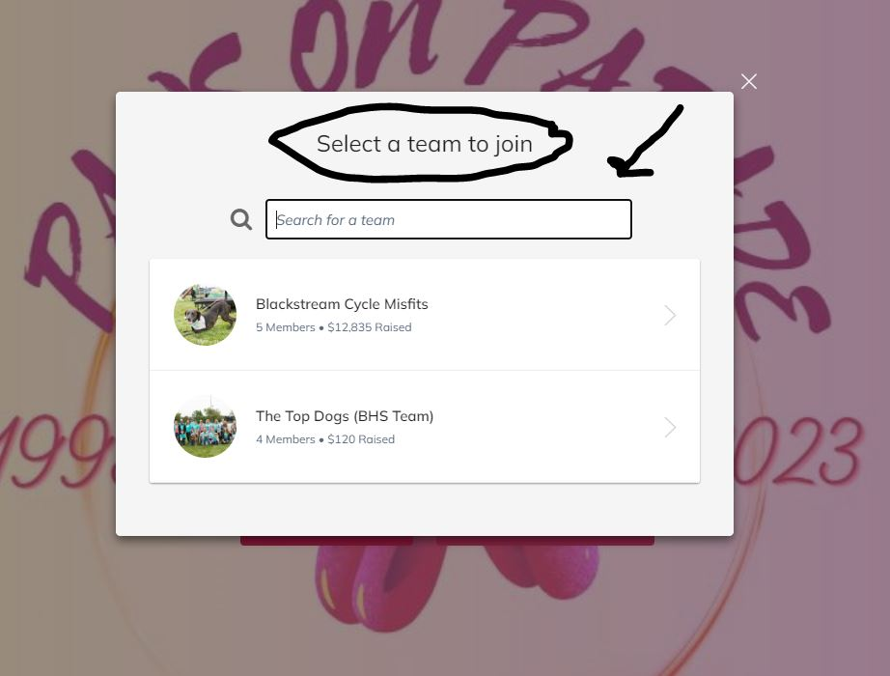

Slide 5
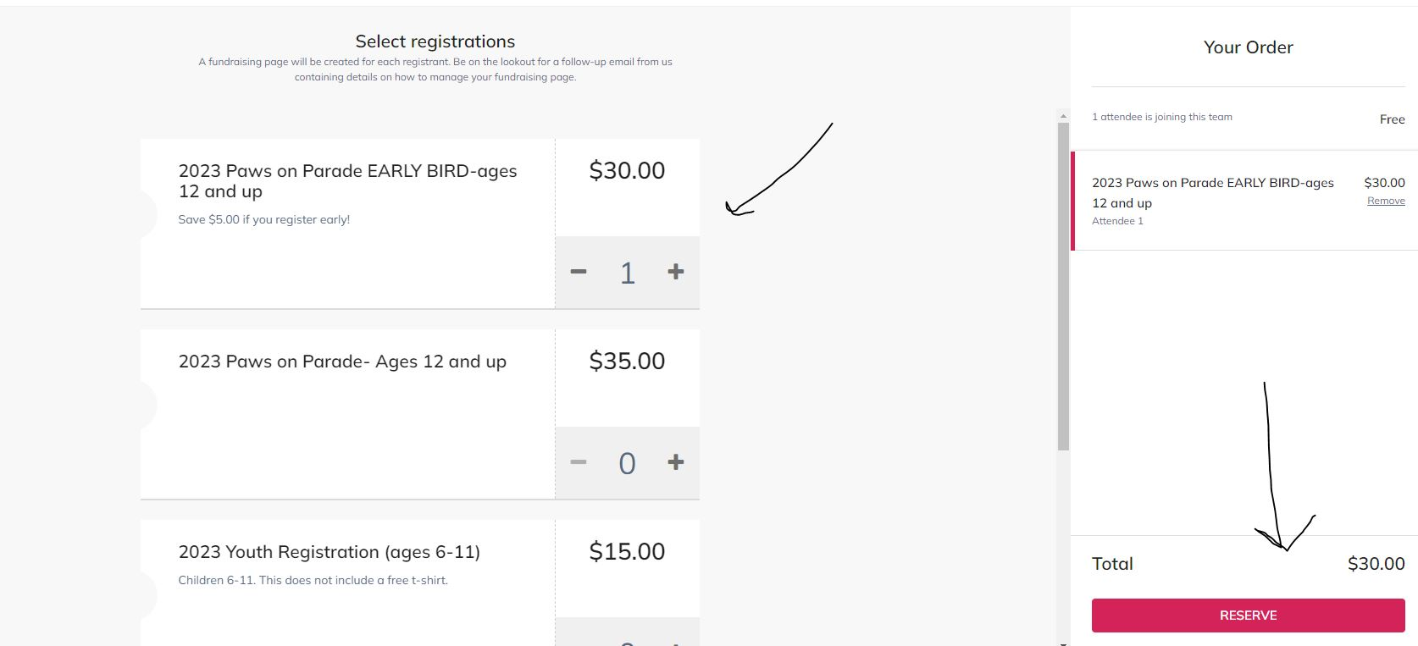

Slide 6
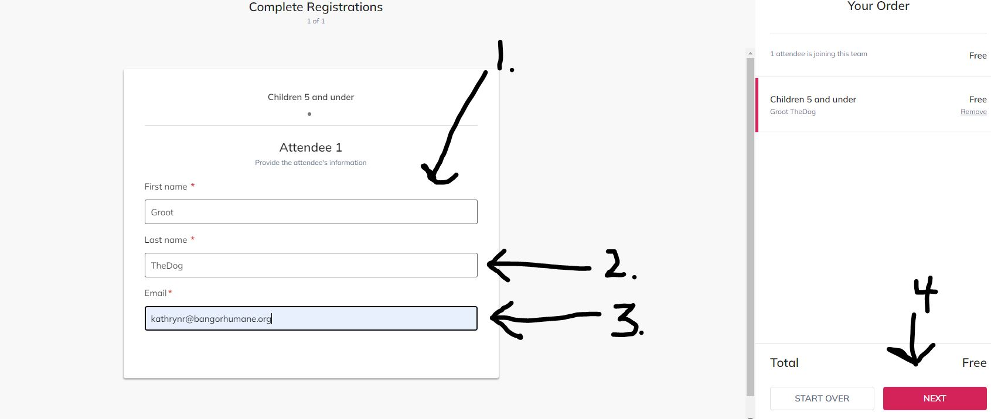

Slide 7
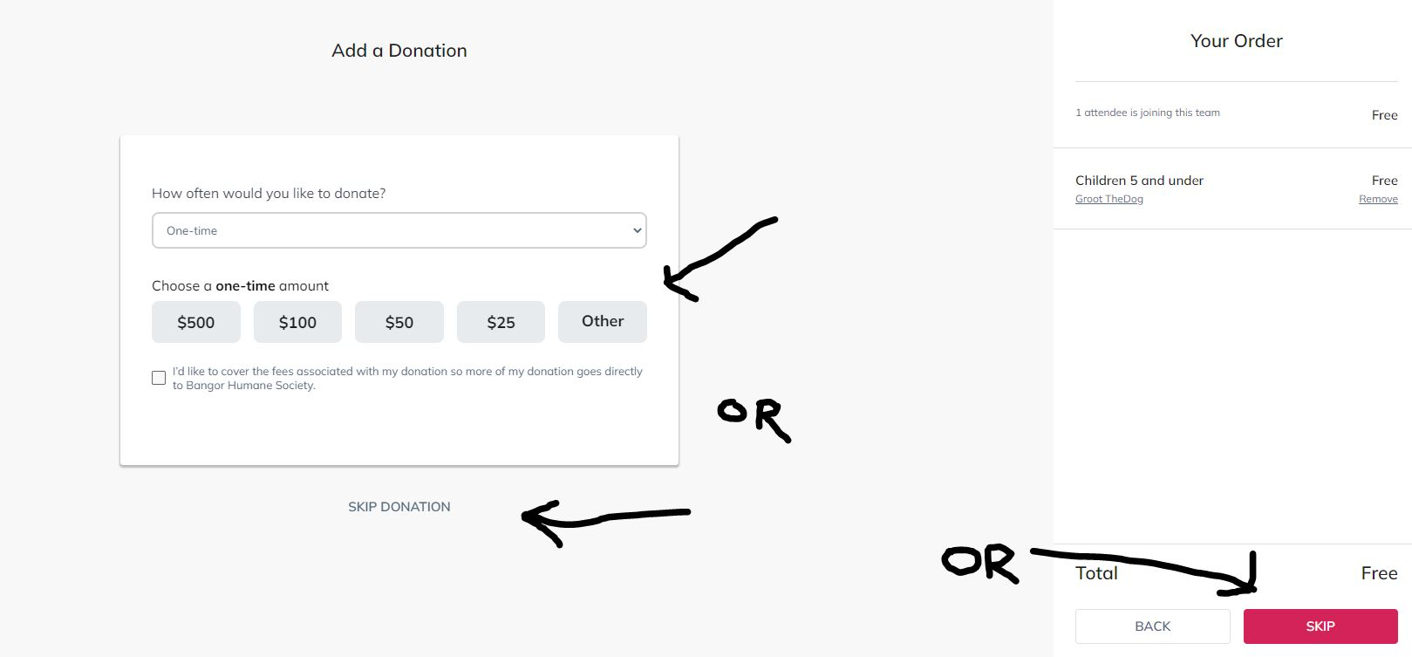

Slide 8
You’ll be prompted to enter your credit card information.

Slide 9
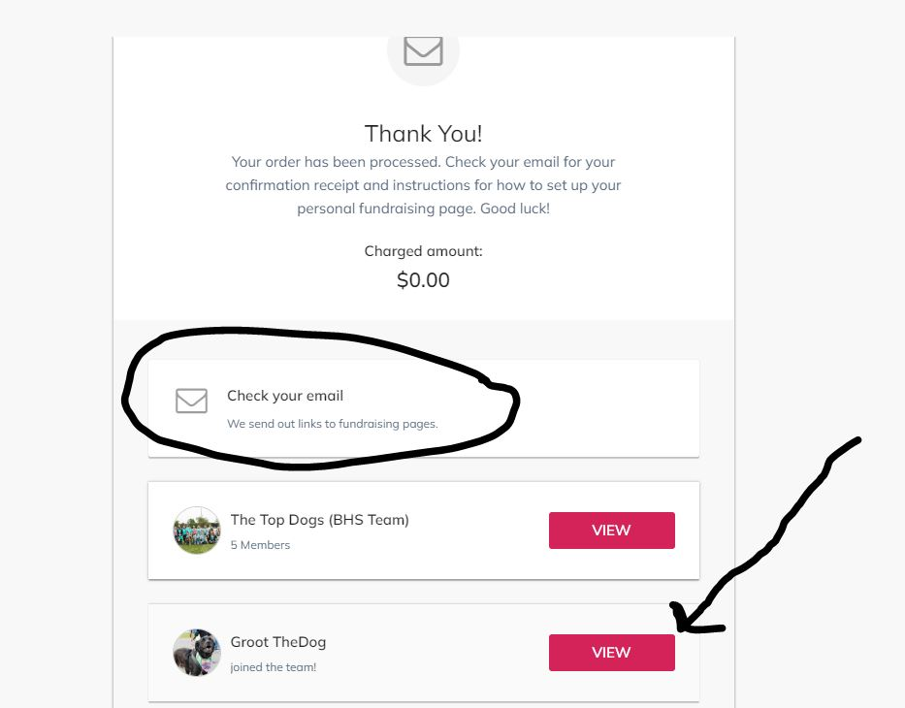

Slide 10
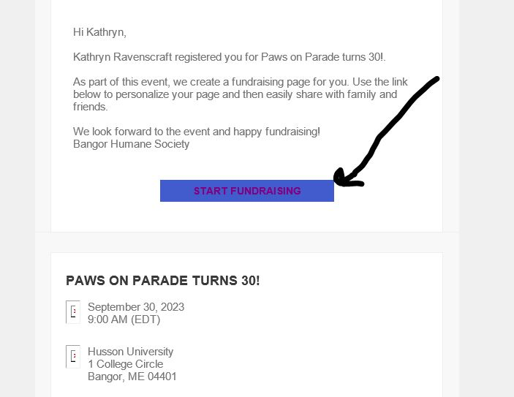

Slide 11
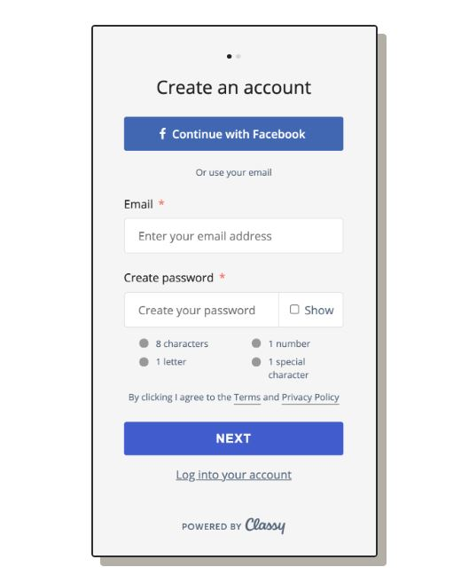

Slide 12
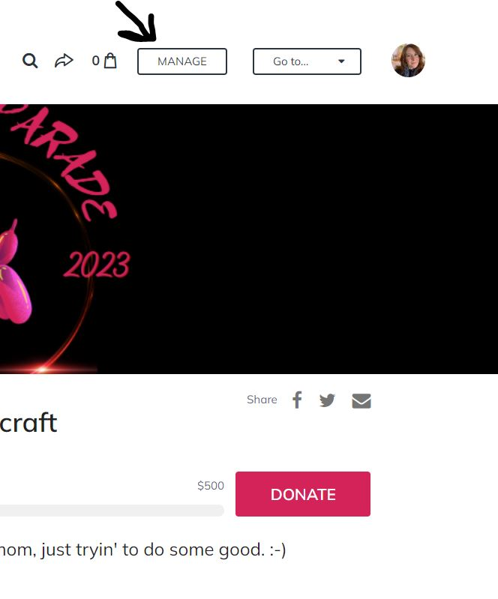

Slide 13
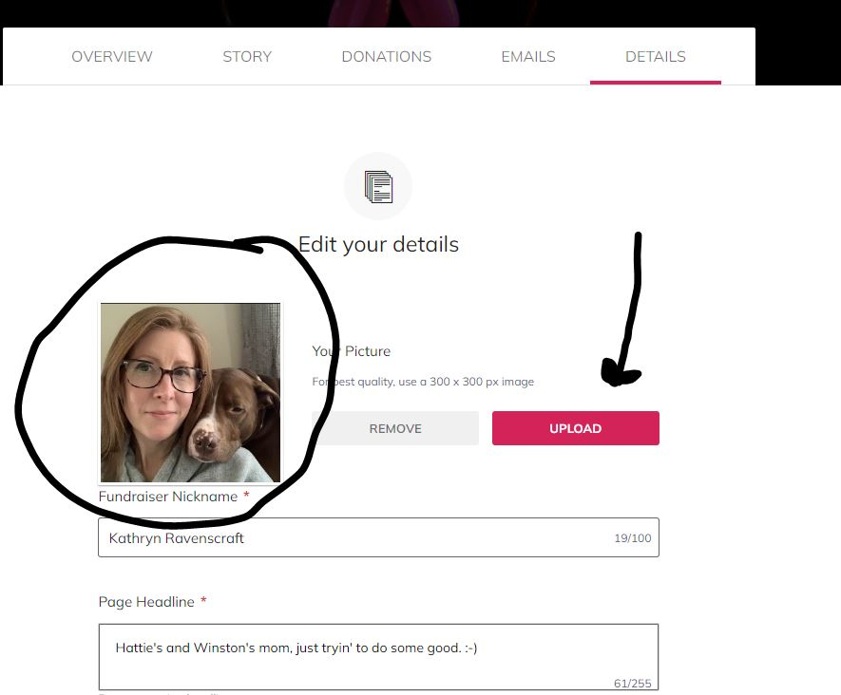

Slide 14
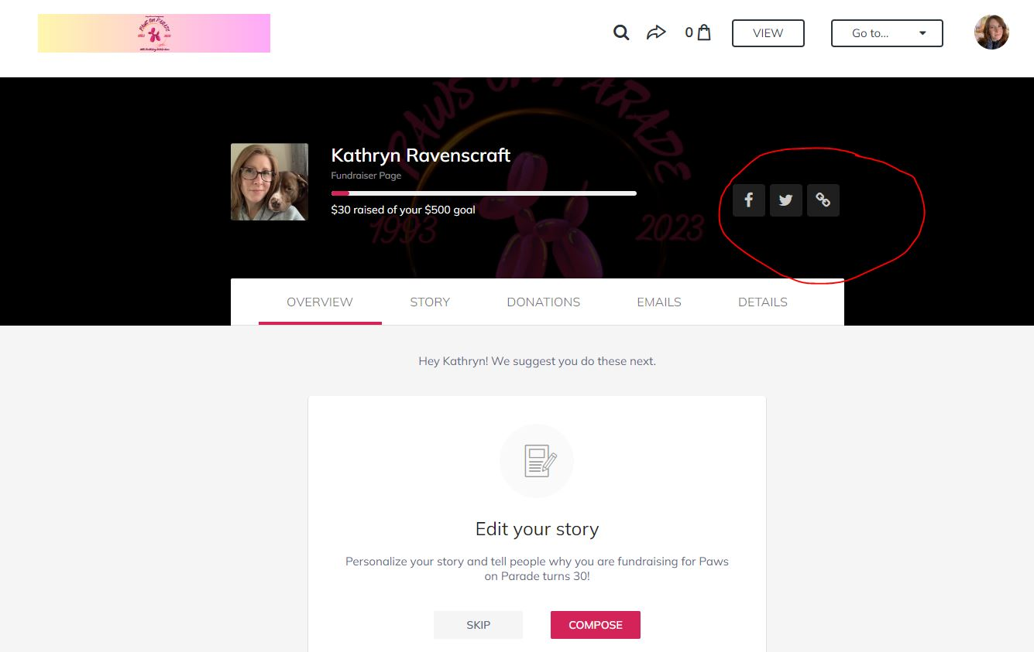

Slide 15
Share, share, share! There are several places to share from!

Slide 16
You can tell people to donate directly from your page, or they can click on the team that appears below your profile photo and join your team!

